Slide 1
Pong in Perl6
Or: everything you should have learned in Mrs. Stevenson’s 10th grade trig class,but totally forgot

Slide 2
SDL -- Simple DirectMedia Layer
Abstraction over many OS sound/video/input/etc.
Two wrapper libs for Perl6: SDL (v1) and SDL2::Raw (v2)
We’ll stick with SDL2::Raw
Perl5 also has SDL lib
Straight C lib wrapper
Except for a few objects, like Rect
Which isn’t all that raw, is it?

Slide 3
Global State -- Background and Paddles
my $bg_rect = SDL_Rect.new( 0, 0, WIDTH, HEIGHT );
my $paddle1_rect = SDL_Rect.new(
PADDLE_MARGIN_LEFT,
(HEIGHT / 2) - (PADDLE_HEIGHT / 2),
PADDLE_WIDTH, PADDLE_HEIGHT,
);
my $paddle2_rect = SDL_Rect.new(
PADDLE_MARGIN_RIGHT,
(HEIGHT / 2) - (PADDLE_HEIGHT / 2),
PADDLE_WIDTH, PADDLE_HEIGHT,
);

Slide 4
Global State -- Ball
my $move_down = 0;
my $move_up = 0;
# Declare as Num (float numbers), avoiding rounding
# to zero if they were Int
my Num $ball_velocity_x;
my Num $ball_velocity_y;
my Num $ball_x = BALL_START_X.Num;
my Num $ball_y = BALL_START_Y.Num;

Slide 5
Init SDL
sub init()
{
SDL_Init( VIDEO );
# Create window with name, position, size, and rendering context (opengl)
my $window = SDL_CreateWindow(
"Pong",
SDL_WINDOWPOS_UNDEFINED_MASK, SDL_WINDOWPOS_UNDEFINED_MASK,
WIDTH, HEIGHT,
OPENGL
);
my $render = SDL_CreateRenderer( $window, -1,
ACCELERATED +| PRESENTVSYNC );
return ($window, $render);
}

Slide 6
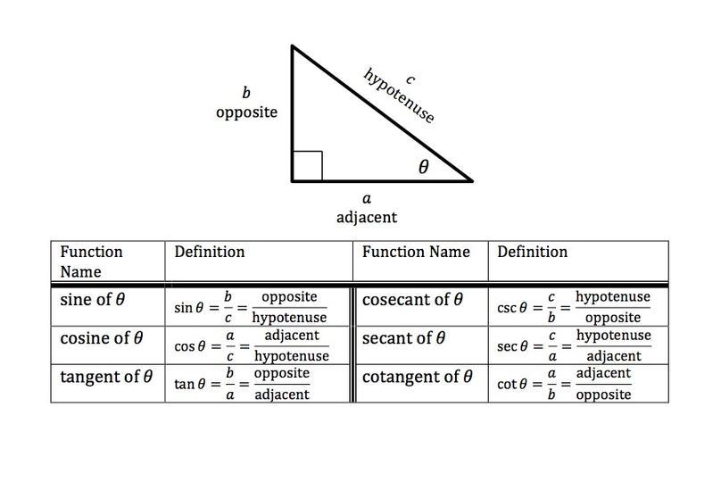
Ball Velocity Through Trig

Slide 7
Set the ball moving
($ball_velocity_x, $ball_velocity_y) = set_rand_ball_angle();
sub set_rand_ball_angle()
{
# Like perl5: @angles = (0..359); $angle = $angles[int rand scalar @angles];
# We use deg2rad() here because sin()/cos()/etc. prefer radians over degrees
# (Remember when Mrs. Stevenson told you to put your calculator into deg mode?)
my $angle = deg2rad( (^360).pick );
my $velocity_x = sin( $angle ) * BALL_MOVE_SPEED;
my $velocity_y = cos( $angle ) * BALL_MOVE_SPEED;
return ($velocity_x, $velocity_y);
}

Slide 8
Main Loop
Games work just like drawn animation--updated frames
Main loop will:
Calculate elapsed time since last frame
Poll for events (input, mostly)
Update physics (location)
Update drawing
Sleep for a bit to maintain a consistent framerate

Slide 9
Main Loop in Action
my Duration $last_elapsed_time;
loop {
my $start_frame = now;
return if ! poll_events();
update_location( $last_elapsed_time ) if $last_elapsed_time;
update_drawing( $window, $render );
my $end_frame = now;
my $elapsed_time = $end_frame - $start_frame;
if $elapsed_time < TIME_PER_FRAME {
my $sleep_time = TIME_PER_FRAME - $last_elapsed_time;
sleep( $sleep_time );
}
$last_elapsed_time = now - $start_frame;
}

Slide 10
Poll Events
my $event = SDL_Event.new;
while SDL_PollEvent( $event ) {
my $casted_event =
SDL_CastEvent( $event );
given $casted_event {
when *.type == QUIT {
say "Quitting";
return;
}
when *.type == KEYDOWN {
my $key = .scancode;
if $key == K_UP {
$move_up = 1;
}
elsif $key == K_DOWN {
$move_down = 1;
}
}
when *.type == KEYUP {
my $key = .scancode;
if $key == K_UP {
$move_up = 0;
}
elsif $key == K_DOWN {
$move_down = 0;
}
}
}
}

Slide 11
Update Physics
sub update_location( Duration $elapsed_time )
{
my Int $paddle_move = (PADDLE_MOVE_SPEED * $elapsed_time).round();
if $move_up {
$paddle1_rect.y = $paddle1_rect.y - $paddle_move;
$paddle1_rect.y = 0
if $paddle1_rect.y < 0
}
if $move_down {
$paddle1_rect.y = $paddle1_rect.y + $paddle_move;
$paddle1_rect.y = PADDLE_BOTTOM_Y
if $paddle1_rect.y > PADDLE_BOTTOM_Y;
}
($ball_x, $ball_y) = calculate_new_ball_location(
$ball_x,
$ball_y,
$elapsed_time,
);
($ball_rect.x, $ball_rect.y) = ($ball_x.round, $ball_y.round);

Slide 12
Calculate ball location
sub calculate_new_ball_location(
Num $cur_ball_x,
Num $cur_ball_y,
Duration $elapsed_time,
)
{
my Num $frame_velocity_x = $ball_velocity_x * $elapsed_time;
my Num $frame_velocity_y = $ball_velocity_y * $elapsed_time;
my Num $new_x = $cur_ball_x + $frame_velocity_x;
my Num $new_y = $cur_ball_y + $frame_velocity_y;

Slide 13
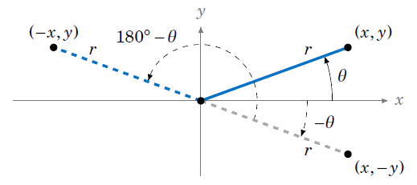
Calculate ball location (2)
#
# Collision detection
#
if $new_y < 0 || ($new_y + $ball_rect.h) >= HEIGHT {
# Hit either the top or bottom. Either way, reverse the Y direction.
$new_y = $cur_ball_y - $frame_velocity_y;
$ball_velocity_y = -$ball_velocity_y;
}

Slide 14
Calculate ball location (3)
if $new_x < 0 {
# Ball on the left side of the screen. You lose!
exit 0;
}
elsif $new_x <= ($paddle1_rect.x + $paddle1_rect.w)
&& $new_y >= $paddle1_rect.y
&& $new_y <= ($paddle1_rect.y + $paddle1_rect.h) {
# Hit player's paddle, reverse X direction
$new_x = $cur_ball_x - $frame_velocity_x;
$ball_velocity_x = -$ball_velocity_x;
}
elsif ($new_x + $ball_rect.w) >= $paddle2_rect.x
&& $new_y >= $paddle2_rect.y
&& $new_y <= ($paddle2_rect.y + $paddle2_rect.h) {
# Hit AI paddle, reverse X direction
$new_x = $cur_ball_x - $frame_velocity_x;
$ball_velocity_x = -$ball_velocity_x;
}

Slide 15
Update Drawing
sub update_drawing( $window, $render )
{
SDL_RenderClear( $render );
SDL_SetRenderDrawColor( $render, 0, 0, 0, 255 );
SDL_RenderFillRect( $render, $bg_rect );
SDL_SetRenderDrawColor( $render, 255, 0, 0, 255 );
SDL_RenderFillRect( $render, $paddle1_rect );
SDL_RenderFillRect( $render, $paddle2_rect );
SDL_SetRenderDrawColor( $render, 0, 255, 0, 255 );
SDL_RenderFillRect( $render, $ball_rect );
SDL_RenderPresent( $render );
return;
}

Slide 16
Done!
Questions? Comments? Praising Rebuttals?

